Slide 1

Machine Translation (German to English)
Iftiaz Ahmed Alfi
ID: 00768112
CSCI 6660, Section: 01
GitHub Link: https://github.com/Iftiaz-Ahmed/Ger2Eng_Translation

Slide 2
Introduction
Multiple paper reviews were done
“Attention is all you need” paper selected for the base of this project
First, transformer concept used that uses only Attention technique to translate sentences
Achieved BLEU score 28.4 on the WMT 2014 English-to-German translation task
Surpassed the state-of-the-art BLEU score of that time
Instead of using the WMT 2014 English-to-German dataset, custom dataset was made for the project
Sources:
Yale University Website
Yale University Facebook
Yale University Twitter

Slide 3
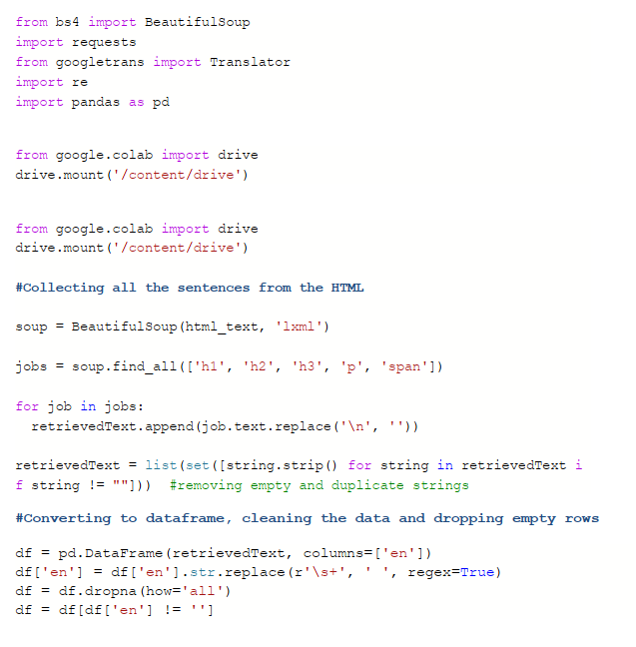
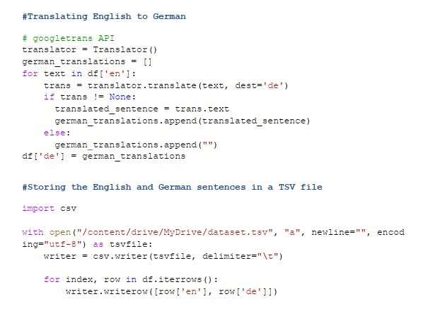
Data collection
Hybrid method followed for data collection
Manual Process
Automatic Process
Manual Process
Contents were normally copied from the websites
Translated using Google Translator
Stored both English and German Sentences parallelly in a CSV file
Automatic Process
Web Scrapping technique was used
Retrieved sentences were cleaned
Translated using Google Translator API
Stored the sentences parallelly in a TSV file
Automatic Data Collection

Slide 4
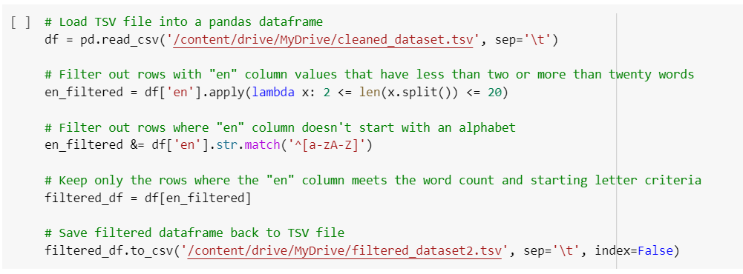
Data Pre-processing
Both English and German sentences were tokenized
German sentence used as a source
English sentence used as target
Field object were created from torchtext.data that adds initial and end token to the sentences, and make the sentences lowercase
1000+ data were collected using the hybrid technique
Sentences with less than 2 and more than 20 words were removed
Duplicate sentences removed
Empty spaces or newlines were handled
Final dataset size 361
Filtering sentences in the dataset

Slide 5
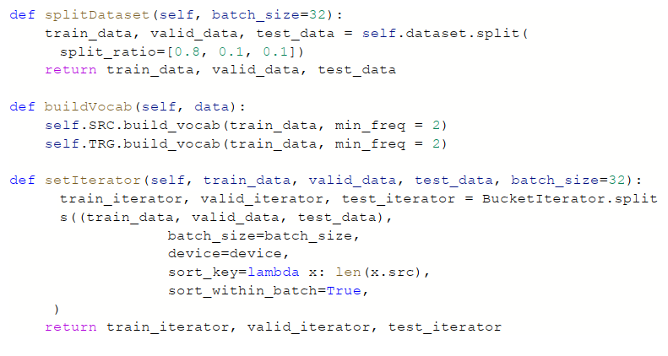
Data Pre-processing
The final TSV dataset was loaded in the form of TabularDataset
The dataset was split into 0.8:0.1:0.1 to train set, validation set and test set simultaneously
Vocabulary was build for both the German and English tokens
BucketIterator used to batch the dataset
Batch Size = 128
Filtering sentences in the dataset

Slide 6
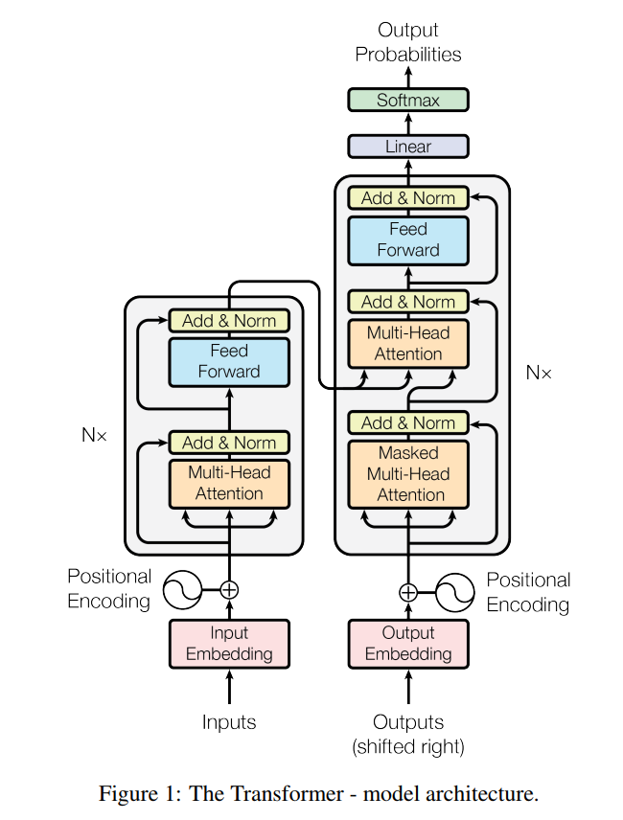
Methodology
The Transformer draws all of the global dependencies between input and output using an attention method
Tokens are first transmitted through common embedding layer
Followed by a positional embedding layer, since the model lacks a recurrent
The vector that results from elementwise summing the token and positional embeddings comprises details about the token and its placement within the sequence
The source sentence is first passed together with its mask into the multi-head attention layer, after which dropout, residual connection, and layer normalization are applied
Then passed through position-wise feedforward layer, dropout, a residual connection, and layer normalization

Slide 7
Methodology
Similarly the target tokens are transmitted through common embedding layer
Then through the positional embedding layer
However, it now has two multi-head attention layers. A masked multi-head attention layer over the target sequence, and a multi-head attention layer which uses the decoder representation as the query and the encoder representation as the key and value.
The decoder representation after the Nth layer is then passed through a feed forward network

Slide 8
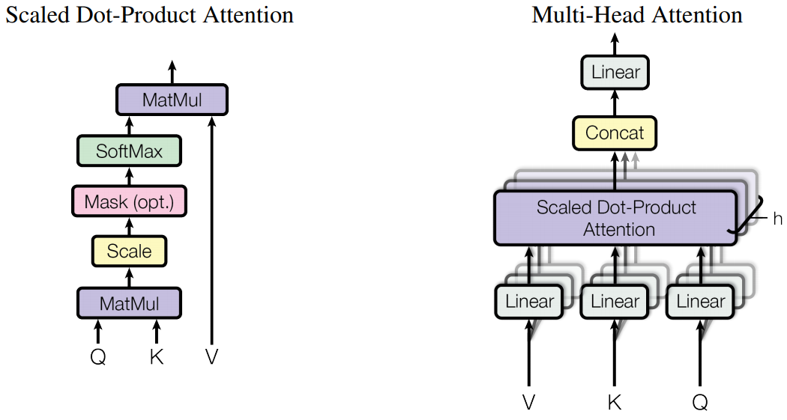
Multi-head attention
This paper introduces Multi-Head Attention
Attention can be thought of as queries, keys and values
The query and key are used to create an attention vector, which is often the result of a SoftMax operation and has all values between 0 and 1 that total to 1
The attention vector is then used to create a weighted sum of the values
Multi-head Attention

Slide 9
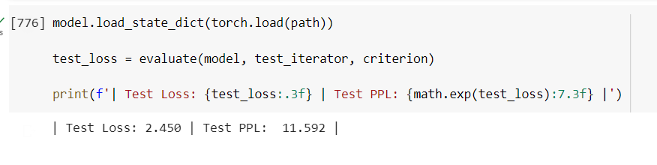
Experiment and result
Hyperparameters used:
Batch Size: 128
Hidden dimension: 256
Encode layer: 3
Decoder layer: 3
Encoder Heads: 8
Decoder Heads: 8
Encoder Dimension: 512
Decoder Dimension: 512
Encoder Dropout = 0.2
Decoder Dropout = 0.2
Learning Rate = 0.0005
Trained for 100 epoch with early stopping if the model
stops learning
Test Loss: 2.450
Test Perplexity: 11.592

Slide 10
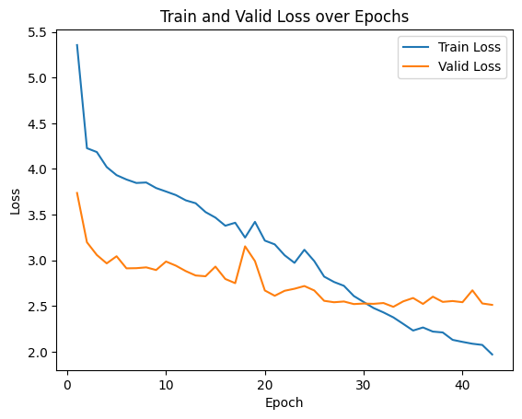
Experiment and result
The train loss and validation loss curve are as follows:

Slide 11
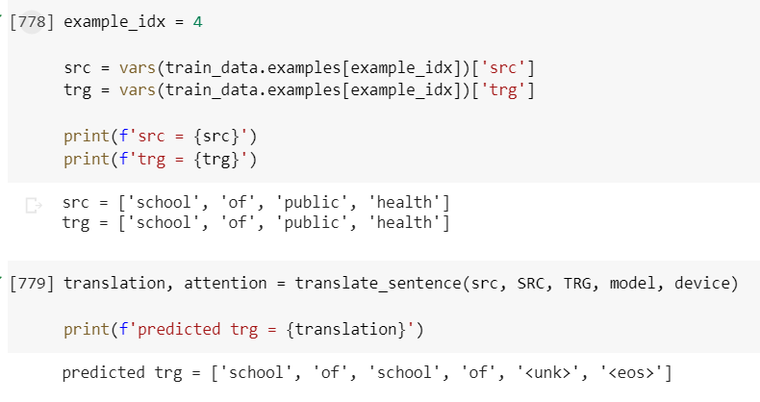
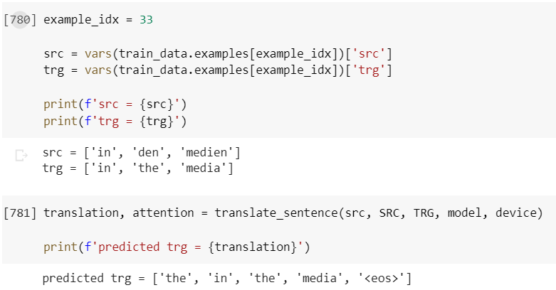
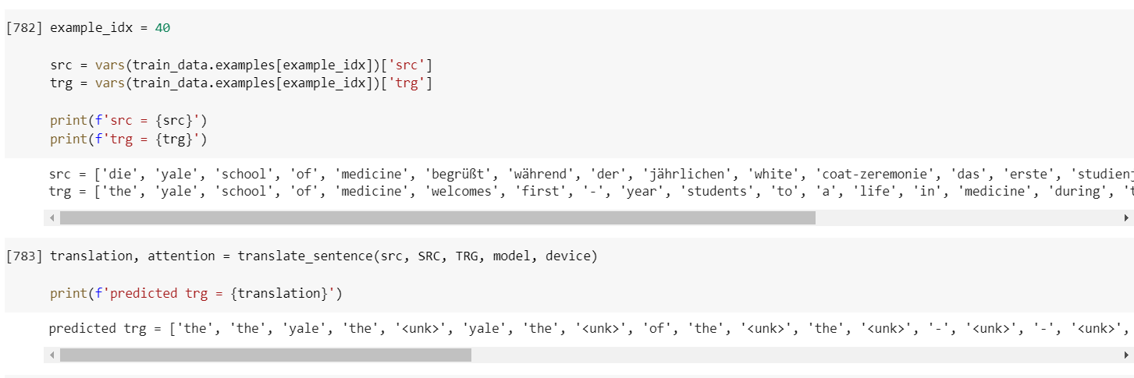
Experiment and result
Experiment 1
Experiment 2
Experiment 3

Slide 12
THANK YOU!!!

